Slide 1

File Operations and Processes
SOFTWARE ENGINEERING

Slide 2
Contents
Working with files (touch, cp, mv, rm)
File archiving and compression (tar, gzip)
Text editors in Linux (nano, vim)
Basic text manipulation (grep, cat, less)
Processes and process management (ps, top, kill)
Running and managing background processes
Redirecting input and output (>, >>, <, |)

Slide 3
Working with files
cp: to make a copy of a file or copy file to another location
touch: create an empty file
mv: To move a file from one location to the other, or to rename it
rm: delete a file permanently
find: to find a file

Slide 4
File archiving and compression
To compress a file in Linux: tar -zcvf file.tar.gz [PATH]
ex: tar -zcvf file.tar.gz file.cpp
-c: Create a new archive.
-z: Compress the archive using gzip.
-v: Verbose mode (optional, shows the progress).
-f: Specifies the archive file name.

Slide 5
exclude directories and files
Compress files but excluding files: tar -zcvf archive.tar.gz --exclude=’[DIRECTORY]’
Compress files but excluding directories: tar -czvf /nfs/backup.tar.gz --exclude=" DIRECTORY " /home/vivek/

Slide 6
Extract a file
tar -xzvf file.tar.gz
tar -xjvf file.tar.bz2
extract the contents of the archive into a specific directory: tar -xzvf my.tar.gz -C [DIRECTORY]
tar -xjvf archive.tar.bz2 -C [DIRECTORY]

Slide 7
Extract a file
-x : Extract files from an archive
-t : List the contents of an archive
-v : Verbose output
-f file.tar.gz : Use archive file
-C DIR : Change to DIR before performing any operations
--exclude : Exclude files matching PATTERN/DIR/FILENAME

Slide 8
Text Editors in Linux
Text Editor: nano
If you already have a txt file: nano _text_file_name.txt
CRTL + O → to save
CTRL + X → to exit
Undo: ALT + U
Redo: ALT + E

Slide 9
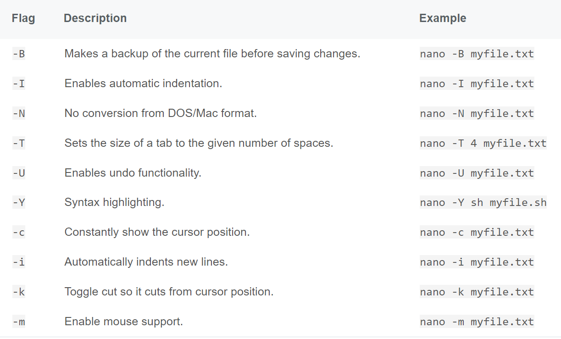
Nano

Slide 10
Other text editors
While the nano command is a powerful and user-friendly text editor, Linux provides other text editors that might better suit your needs, particularly as you become more experienced. Two of the most popular alternatives are Vi and Emacs.

Slide 11
vi
vi myfile.txt
a. press 'i' to enter insert mode
ex: This is some text.
c. press 'Esc' to exit insert mode
d. type ':wq' to save and quit
e. Output: 'myfile.txt' 1L, 18C written

Slide 12
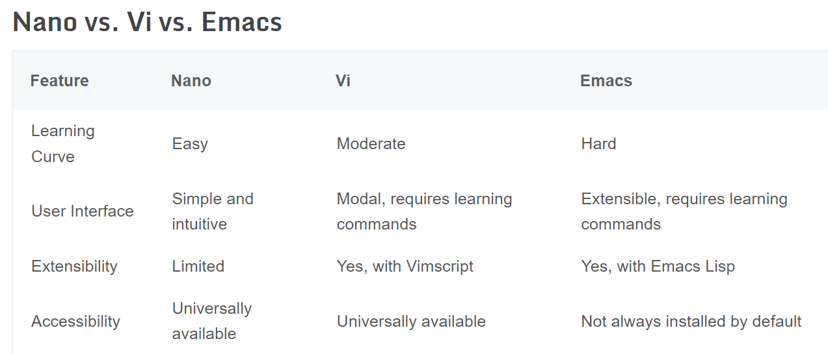

Slide 13
Basic text manipulation
1. grep
2. cat
3. less
4. head
5. tail

Slide 14
grep
The grep filter searches a file for a particular pattern of characters and displays all lines that contain that pattern. The pattern that is searched in the file is referred to as the regular expression (grep stands for global search for regular expression and printout).
grep [options] pattern [files]
[options]: These are command-line flags that modify the behavior of grep.
[pattern]: This is the regular expression you want to search for.

Slide 15
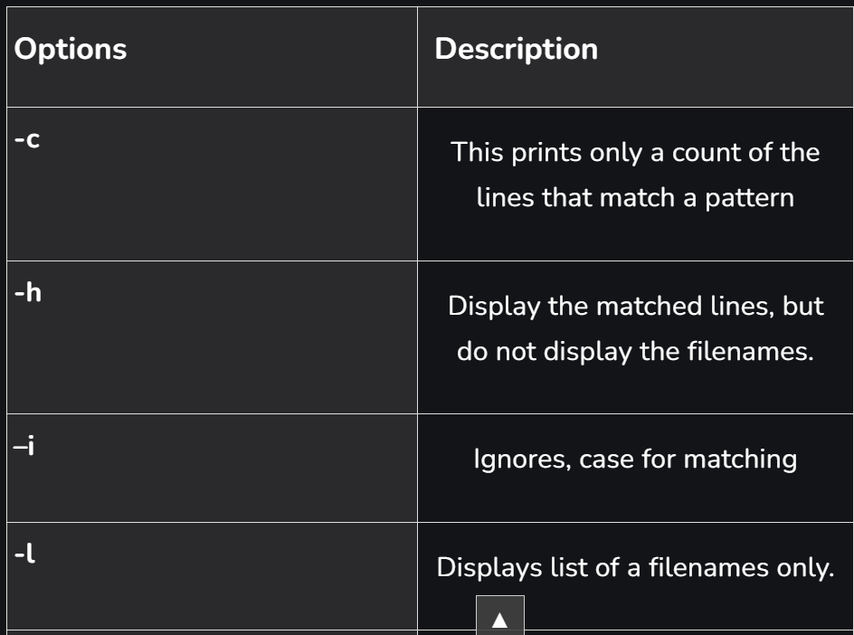
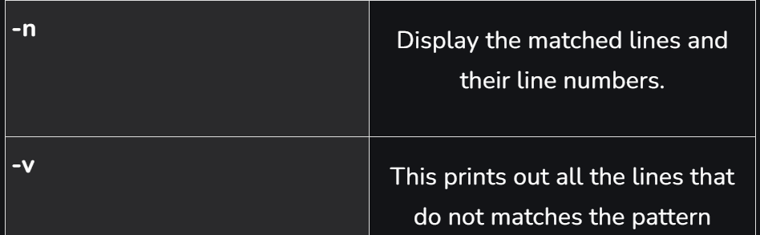
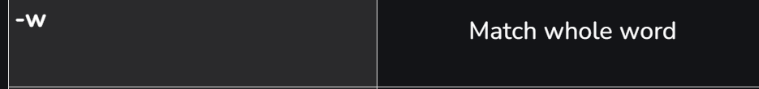
grep

Slide 16
Cat, less
The cat command is the simplest way to view the contents of a file. It displays the contents of the file(s) specified on to the output terminal. Used for simple and short files: cat FILENAME
The less command is similar to the more command but provides extensive features. One important one is that it allows backward as well as forward movement in the file: less FILENAME
Use g and G to go up or down, q to exit

Slide 17
Head, tail
As their names imply, the head command will output the first part of the file, while the tail command will print the last part of the file. Both commands write the result to standard output: head [OPTIONS] FILES
Both allow the display of a certain number of lines
tail [OPTIONS] FILES

Slide 18
Processes and process management
Processes and process management are fundamental concepts in Linux and other operating systems. Understanding and effectively managing processes is crucial for the stability, performance, and security of a Linux system.
A process is an instance of a program currently running on a computer system. In Linux, processes are managed by the operating system's kernel, which allocates system resources and schedules processes to run on the CPU. Understanding and managing processes is a critical skill for Linux administrators and developers.

Slide 19
ps
Sometimes, we want to close unresponsive programs or check if a background process has started in our Linux system.
The ps command in Linux is used for displaying information about processes. It provides a snapshot of the currently running processes on the system. The ps command has various options that allow you to customize the output according to your requirements: ps [options]
PID – the process id
TTY – terminal associated with the process
TIME – elapsed CPU utilization time for the process
CMD – the executable command

Slide 20
top, kill
Top is used to list all running Linux processes on your system: top
To kill a process: kill [PID]

Slide 21
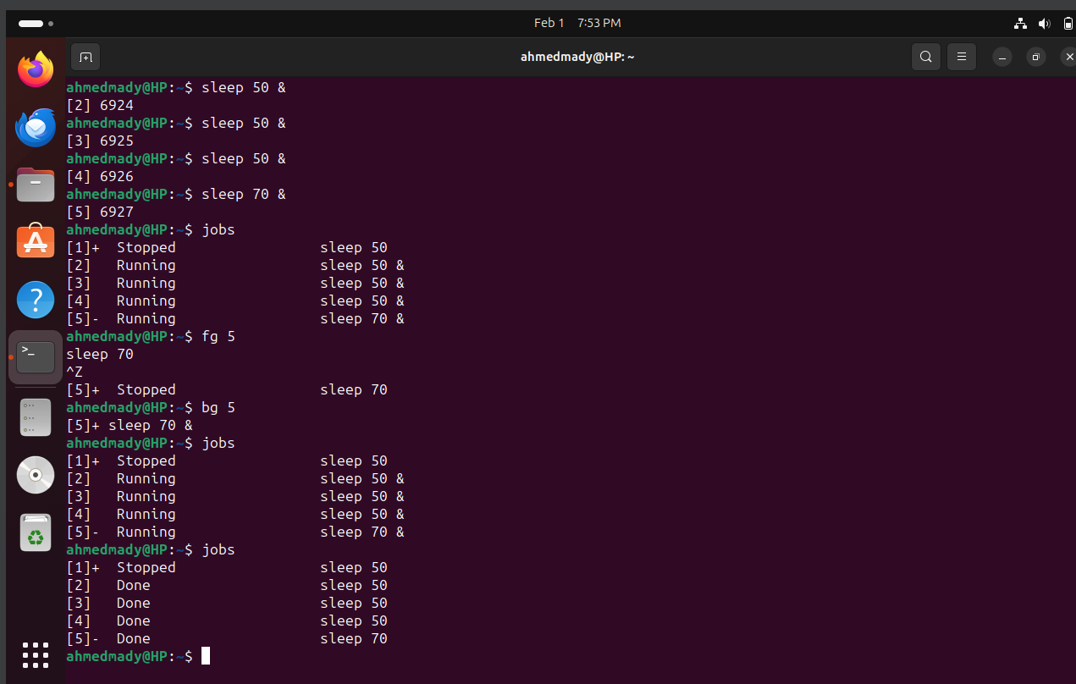
Running and managing background processes

Slide 22
echo
The echo command is a way to communicate with your Linux terminal. It allows you to send text, variables, and special characters to the standard output, which is usually the terminal screen. The echo command is like a messenger that delivers your words to the terminal.

Slide 23
Redirecting input and output
The ‘>‘ symbol is used for output (STDOUT) redirection overriding the file: > : ls –al > record.txt
If the contents of the file are to be added and not overwritten: >> : ls –n text >> record.txt
The ‘<‘ symbol is used for input(STDIN) redirection : Mail -s "Subject" to-address < Filename
wc –l < records.txt

Slide 24
|
In Linux, the vertical bar (|) is known as a "pipe" and is used to connect the output of one command to the input of another. This allows you to create a pipeline of commands, where the output of one command becomes the input for the next command. The | symbol is commonly used in the command line to enhance the functionality and flexibility of Linux commands.
ls | grep file.txt

Slide 25
Word count
wc [file]: returns is the file's number of lines, words, and characters, followed by its path.

Slide 26
Diff command
Its primary purpose is to compare the contents of two files and display the differences between them. diff [FILE1] [FILE2]
Can compare 2 versions of the same file

Slide 27
Create 2 text files, 1 file using nano, and the other using cp command
Edit the second file any text u add
Use diff command to display the added text

Slide 28
References
https://www.allhandsontech.com/linux/linux-commands-files/
https://www.cyberciti.biz/faq/how-to-tar-a-file-in-linux-using-command-line/
https://ioflood.com/blog/nano-linux-command/#:~:text=To%20use%20the%20nano%20command,will%20create%20it%20for%20you.
https://www.baeldung.com/linux/head-tail-commands

